Slide 1

By Paul Cowan: http://tech.groups.yahoo.com/group/glasgow_altdotnet_usersgroup/

Slide 2

Speaker
Paul Cowan
Cutting-Edge Solutions (Scotland)
dagda1@scotalt.net
http://the-software-simpleton.blogspot.com/

Slide 3
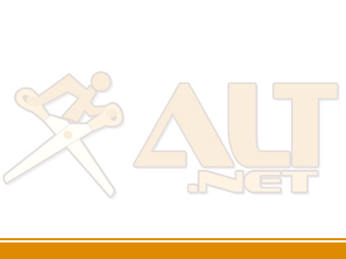
Agenda
Some alternatives you might not know about!
What is Inversion Of Control?
What defines testability (TDD)
IoC and Testability

Slide 4
What is Inversion
Of Control?

Slide 5
Problems with typical coding techniques
Difficult or impossible to test
Tightly coupled
Violates the single responsibility principle
Violates the open closed principle
Glasgow ALT.NET User Group: http://tech.groups.yahoo.com/group/glasgow_altdotnet_usersgroup/

Slide 6
The goal of good architecture
Don’t repeat yourself (DRY)
Decreased coupling
Separation of concerns
Reduced cost of change
Greater flexibility
Do more for less ££££
Glasgow ALT.NET User Group: http://tech.groups.yahoo.com/group/glasgow_altdotnet_usersgroup/

Slide 7
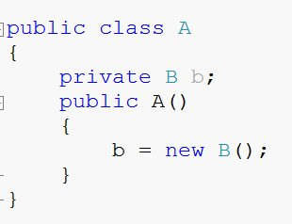
What is Inversion of Control?
1. Class A needs a reference to Class B
2. Class B is a concrete class that has a default constructor.
3. Class A owns an instance of class B.
4. Class A needs a reference to Class B
Glasgow ALT.NET User Group: http://tech.groups.yahoo.com/group/glasgow_altdotnet_usersgroup/

Slide 8
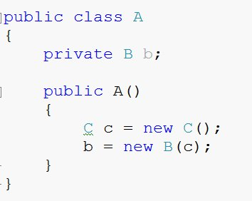
What is Inversion of Control?
1. You now need an instance of C in order to create B.
2. If class C or B changes then A needs to know about it.
Glasgow ALT.NET User Group: http://tech.groups.yahoo.com/group/glasgow_altdotnet_usersgroup/

Slide 9
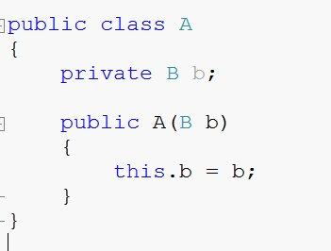
What is Inversion of Control?
1. An instance of B is now ‘injected’ into A.
2. A does not know how b was instansiated.
3. Responsibility of creating B moves from the object to the framework.
2. A does not know how b was instanciated.
Glasgow ALT.NET User Group: http://tech.groups.yahoo.com/group/glasgow_altdotnet_usersgroup/

Slide 10
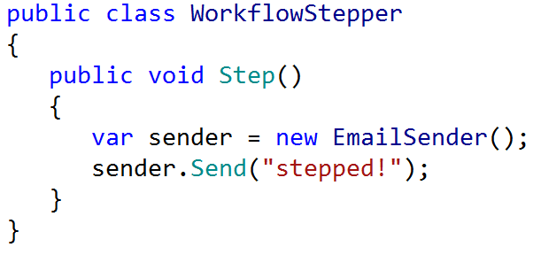
What is Inversion of Control?
Glasgow ALT.NET User Group: http://tech.groups.yahoo.com/group/glasgow_altdotnet_usersgroup/

Slide 11
What is Inversion of Control?
Relationship is set
at compile time.
Glasgow ALT.NET User Group: http://tech.groups.yahoo.com/group/glasgow_altdotnet_usersgroup/

Slide 12
What is Inversion of Control?
new isn’t always viable.
Glasgow ALT.NET User Group: http://tech.groups.yahoo.com/group/glasgow_altdotnet_usersgroup/

Slide 13
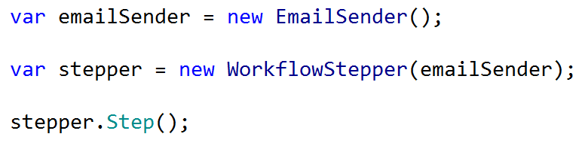
What is Inversion of Control?
Glasgow ALT.NET User Group: http://tech.groups.yahoo.com/group/glasgow_altdotnet_usersgroup/

Slide 14
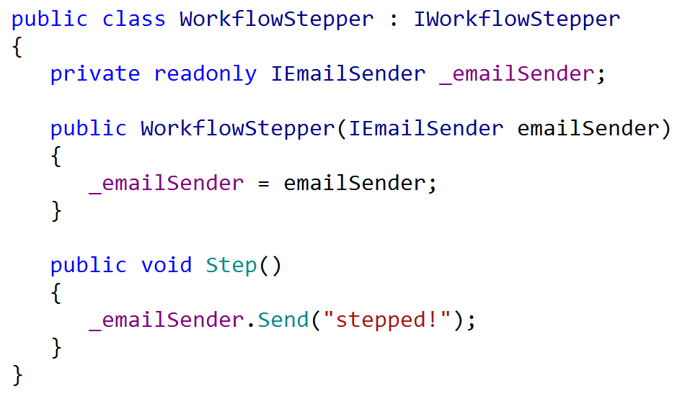
What is Inversion of Control?
Glasgow ALT.NET User Group: http://tech.groups.yahoo.com/group/glasgow_altdotnet_usersgroup/

Slide 15
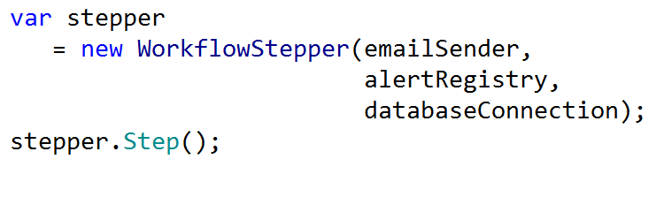
What is Inversion of Control?
Glasgow ALT.NET User Group: http://tech.groups.yahoo.com/group/glasgow_altdotnet_usersgroup/

Slide 16
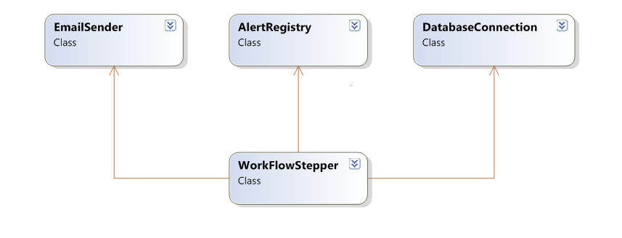
What is Inversion of Control?
Glasgow ALT.NET User Group: http://tech.groups.yahoo.com/group/glasgow_altdotnet_usersgroup/

Slide 17
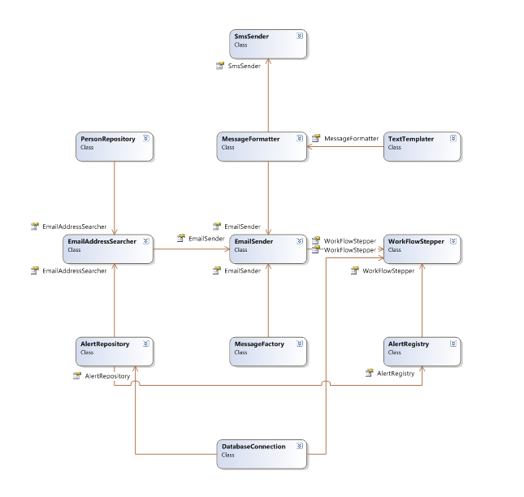

Slide 18
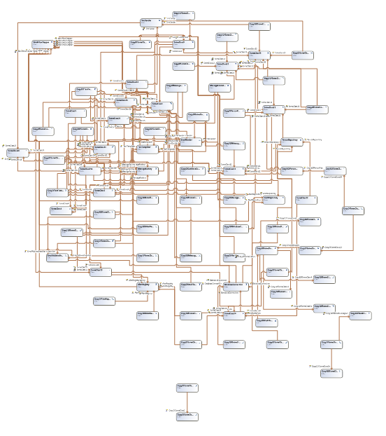

Slide 19
What is Inversion of Control?
A way of designing reusable components
A way of decoupling services
‘Inject’ dependencies through constructor or parameters (Dependency Injection)
Technique to reduce coupling by moving configuration and dependency wiring outside a component.
Glasgow ALT.NET User Group: http://tech.groups.yahoo.com/group/glasgow_altdotnet_usersgroup/

Slide 20
Vocabulary
Service = Interface (IEmailSender)
Component = Class (EmailSender)
BUT
Not all classes are components
Glasgow ALT.NET User Group: http://tech.groups.yahoo.com/group/glasgow_altdotnet_usersgroup/

Slide 21
Components
Components must be composable
A Independently deployable
Make their context dependencies explicit.
Glasgow ALT.NET User Group: http://tech.groups.yahoo.com/group/glasgow_altdotnet_usersgroup/

Slide 22
IoC AND Dependency Injection
Inversion of Control
  A concept
  Relinquishing the responsibility of managing dependencies.
Dependency Injection
  A pattern
  Constructor injection
  Property injection
Glasgow ALT.NET User Group: http://tech.groups.yahoo.com/group/glasgow_altdotnet_usersgroup/

Slide 23
IoC design style
Systems are composed of small specialised services
  Represented by interfaces
Components declare
  The services they provide (by implementation)
  The services they require (by DI)
Components do not dictate their own lifestyle
  Do not implement singleton yourself
Let TDD drive your design
Glasgow ALT.NET User Group: http://tech.groups.yahoo.com/group/glasgow_altdotnet_usersgroup/

Slide 24
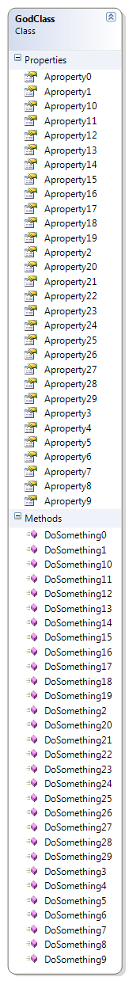
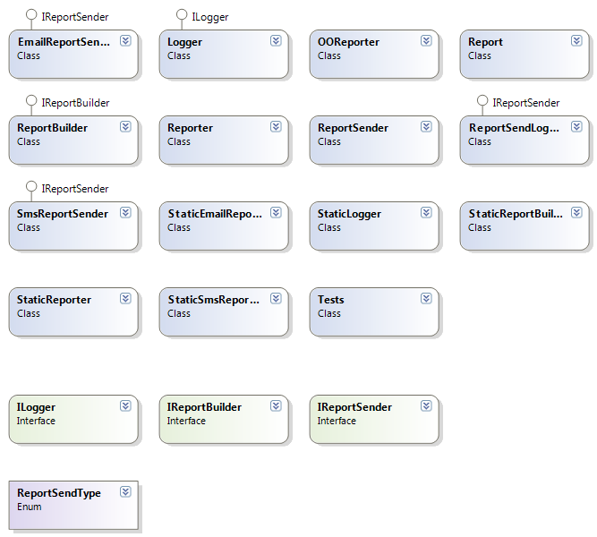
Break Large pieces into small
Glasgow ALT.NET User Group: http://tech.groups.yahoo.com/group/glasgow_altdotnet_usersgroup/

Slide 25
What is an IoC Container
A (very) smart factory
Automatically resolves dependencies
Automatically injects concrete instances
All services are registered in the container
Single point of access for services
Transparent
Various implementations for .NET
Glasgow ALT.NET User Group: http://tech.groups.yahoo.com/group/glasgow_altdotnet_usersgroup/

Slide 26
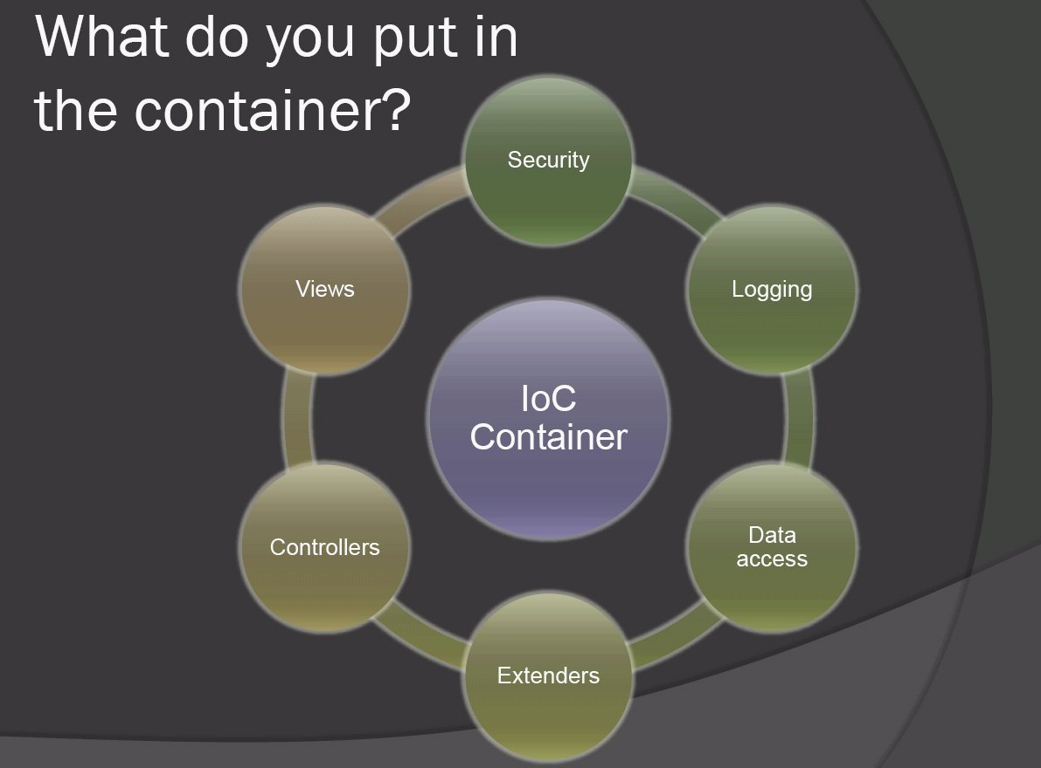
What is Invesion of Control?
Glasgow ALT.NET User Group: http://tech.groups.yahoo.com/group/glasgow_altdotnet_usersgroup/

Slide 27
Castle MicroKernel / Windsor
Part of the Castle Project castleproject.org
Started by Hamilton Verissimo
Also includes:
  MonoRail MVC framework for ASP.NET
  ActiveRecord based on NHibernate
Glasgow ALT.NET User Group: http://tech.groups.yahoo.com/group/glasgow_altdotnet_usersgroup/

Slide 28
Other Containers
Structuremap (http://structuremap.sourceforge.net/Default.htm)
Spring.NET (http://www.springframework.net/)
Autofac (http://code.google.com/p/autofac/)
Unity (http://codeplex.com/unity)
Glasgow ALT.NET User Group: http://tech.groups.yahoo.com/group/glasgow_altdotnet_usersgroup/
Glasgow ALT.NET User Group: http://tech.groups.yahoo.com/group/glasgow_altdotnet_usersgroup/

Slide 29
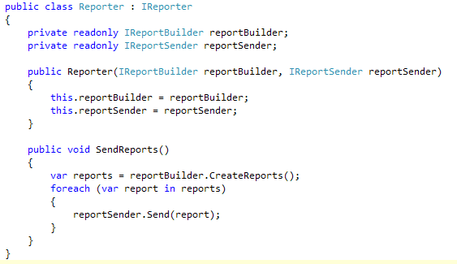
What is an IoC Container
Glasgow ALT.NET User Group: http://tech.groups.yahoo.com/group/glasgow_altdotnet_usersgroup/

Slide 30
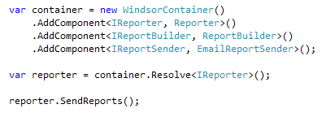
What is an IoC Container
Glasgow ALT.NET User Group: http://tech.groups.yahoo.com/group/glasgow_altdotnet_usersgroup/

Slide 31
There is no new
Notes:
Finish demo here.

Slide 32
Inversion of Control
Inversion Of Control, Dependency Injection, The Hollywood Principal etc.
Instead of instantiating concrete class references in your class, depend on an abstraction and allow your concrete dependencies to be given to you.
Glasgow ALT.NET User Group: http://tech.groups.yahoo.com/group/glasgow_altdotnet_usersgroup/

Slide 33
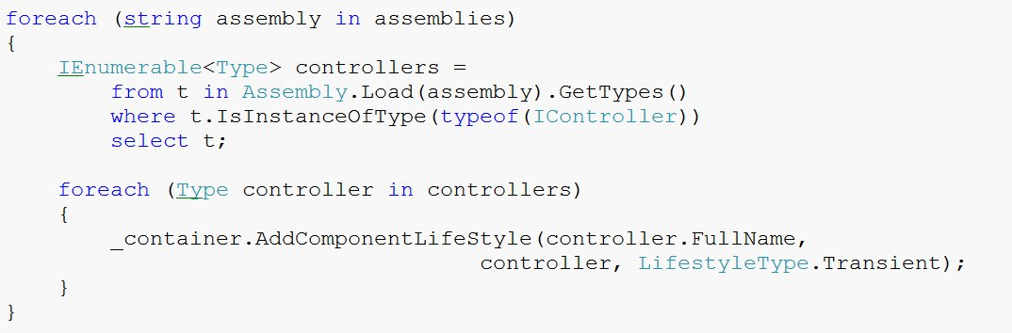
Auto-wiring Example
Glasgow ALT.NET User Group: http://tech.groups.yahoo.com/group/glasgow_altdotnet_usersgroup/

Slide 34
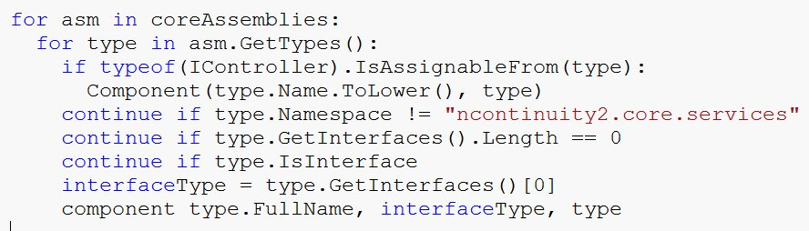
Binsor
Glasgow ALT.NET User Group: http://tech.groups.yahoo.com/group/glasgow_altdotnet_usersgroup/

Slide 35
Lifestyles
Singleton (the default)
Transient
Per Thread
Pooled
Per Web Request
Custom
Glasgow ALT.NET User Group: http://tech.groups.yahoo.com/group/glasgow_altdotnet_usersgroup/

Slide 36
Pros?
Simpler component architecture
Reduced cost of change
Easy to unit test
Easily move between application configurations
Ready made configuration (IoC containers)
Glasgow ALT.NET User Group: http://tech.groups.yahoo.com/group/glasgow_altdotnet_usersgroup/

Slide 37
Cons?
Not another thing to learn?
Higher level of abstraction
Performance?
Lifestyle mistakes can be hard to diagnose
Can’t do obfuscation and configuration
Maybe it’s time we looked at dynamically typed languages?
Glasgow ALT.NET User Group: http://tech.groups.yahoo.com/group/glasgow_altdotnet_usersgroup/

Slide 38
Should I use it?
Already familiar with OO principles and patterns?
Already writing unit tests?
Using a statically typed language?
If not, learn how to do these first
Don’t impose an IoC container on a team which can’t see its benefit
Glasgow ALT.NET User Group: http://tech.groups.yahoo.com/group/glasgow_altdotnet_usersgroup/

Slide 39
Advanced Usage
Facilities
Facilities supplement the IOC with a new technology
Transaction Facility
[Transaction(TransactionMode.RequiresNew)]
public CallTree MoveContact(Guid responderUid, Guid replacementUid)
{
}
NHibernate Facility
Interceptors
public void Intercept(IInvocation invocation)
{
MethodInfo methodInfo = invocation.MethodInvocationTarget;
if ((methodInfo == null) || (!_metaInfo.Contains(methodInfo)))
{
invocation.Proceed();
return;
}
Glasgow ALT.NET User Group: http://tech.groups.yahoo.com/group/glasgow_altdotnet_usersgroup/

Slide 40
Test Driven Development

Slide 41
What is a “Unit Test”
It’s a design method
The purpose of the tests in TDD is to drive out the design of the system.
You write a test before writing the code in order to clarify in your mind what the code should do when you write it?
Glasgow ALT.NET User Group: http://tech.groups.yahoo.com/group/glasgow_altdotnet_usersgroup/

Slide 42
TDD Myths
Myth
Truth
It’s a QA technique
It’s a development approach
It’s a substitute to design & modelling,
traditional QA
Its orthogonal to design &
modelling traditional QA
It curtails productivity
Most who apply it consider it a
productivity technique but the
the jury is still out
Glasgow ALT.NET User Group: http://tech.groups.yahoo.com/group/glasgow_altdotnet_usersgroup/

Slide 43
TDD Myth
TDD results in a regression test suite
Myth because
You may be using an application framework or 3rd party component
You may be working on a legacy system
You may not have adequate tool support for UI testing or database testing.
Glasgow ALT.NET User Group: http://tech.groups.yahoo.com/group/glasgow_altdotnet_usersgroup/

Slide 44
TDD Myth
TDD automatically produces quality code
Myth because
An inexperienced developer using TDD can still produce low quality code.
A development group will still need code reviews or other mechanisms to ensure code quality
Glasgow ALT.NET User Group: http://tech.groups.yahoo.com/group/glasgow_altdotnet_usersgroup/

Slide 45
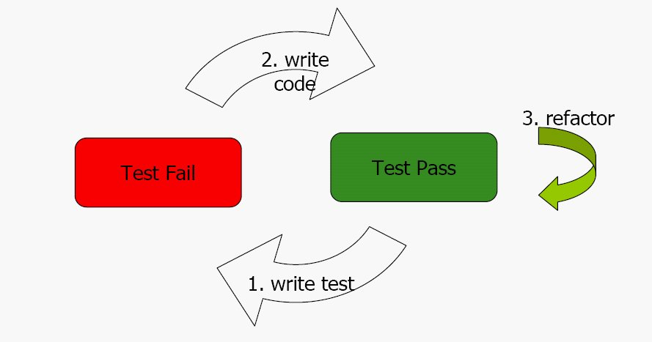
TDD Cycle
Glasgow ALT.NET User Group: http://tech.groups.yahoo.com/group/glasgow_altdotnet_usersgroup/

Slide 46
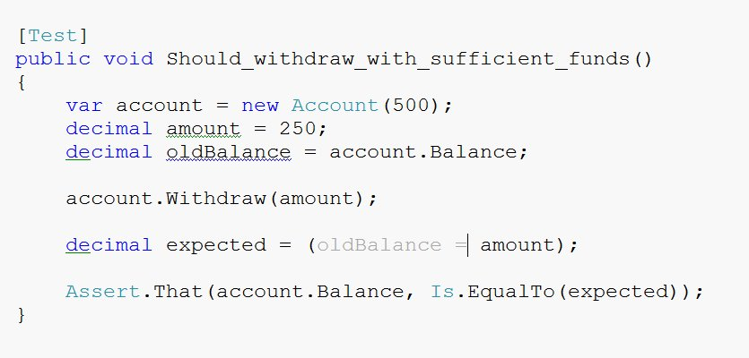
Unit test example
Glasgow ALT.NET User Group: http://tech.groups.yahoo.com/group/glasgow_altdotnet_usersgroup/

Slide 47
Properties of a good unit test
They run fast
They run in isolation
They provide documentation in the form of examples of how to invoke components of the system.
They represent progress towards the solution
Glasgow ALT.NET User Group: http://tech.groups.yahoo.com/group/glasgow_altdotnet_usersgroup/

Slide 48
Pure Unit Tests
A test is not “pure” if it
Talks to the database
It communicates across the network
It touches the file system
All “pure" unit tests for a system can be run many times a day as part of the TDD cycle.
Glasgow ALT.NET User Group: http://tech.groups.yahoo.com/group/glasgow_altdotnet_usersgroup/

Slide 49
Mocks and other test doubles
If you cannot test code – change it so you can
Test first
Only one concrete class per test – MOCK THE REST
Glasgow ALT.NET User Group: http://tech.groups.yahoo.com/group/glasgow_altdotnet_usersgroup/

Slide 50
Mocking
Mock objects are simulated objects that mimic the behaviour of real objects in controlled ways.
A computer programmer typically creates a mock object to test the behaviour of some other object.
Glasgow ALT.NET User Group: http://tech.groups.yahoo.com/group/glasgow_altdotnet_usersgroup/

Slide 51
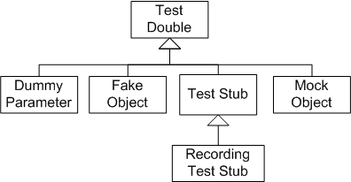
Mocking
Glasgow ALT.NET User Group: http://tech.groups.yahoo.com/group/glasgow_altdotnet_usersgroup/

Slide 52
Rhino Mocks 3.5
Main feature of 3.5 is the AAA syntax
Arrange or set up the test scenario
Act or carry out the functionality
Assert that our expectations are true
Glasgow ALT.NET User Group: http://tech.groups.yahoo.com/group/glasgow_altdotnet_usersgroup/

Slide 53
How to write good TDD specifications
What is the next important thing the system doesn’t do
Template for TDD scenarios
Given some initial context
When an event occurs
Then ensure some outcomes
Glasgow ALT.NET User Group: http://tech.groups.yahoo.com/group/glasgow_altdotnet_usersgroup/

Slide 54
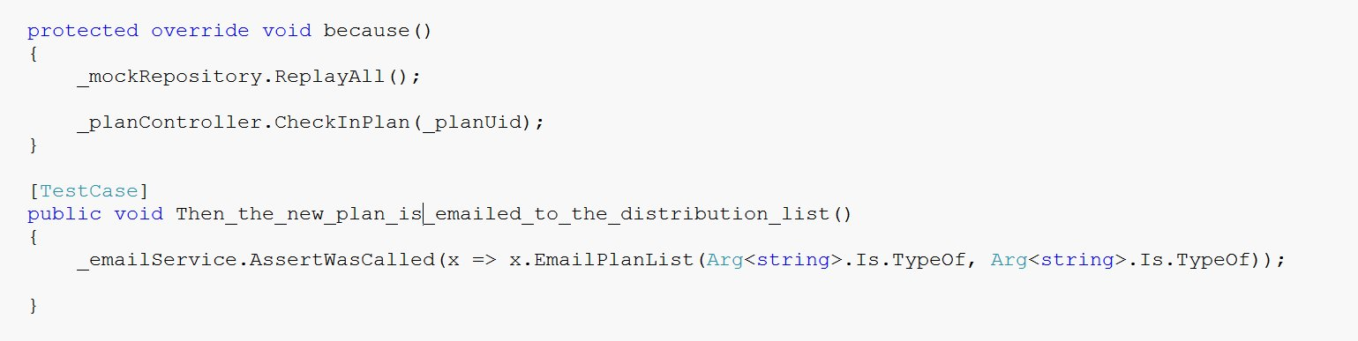
Example
Glasgow ALT.NET User Group: http://tech.groups.yahoo.com/group/glasgow_altdotnet_usersgroup/

Slide 55
TDD Encourages
DRY – Don’t repeat yourself
KISS – Keep It Simple Stupid
YAGNI – You Aint Going To Need It
SRP – Single Responsibility Pattern
IOC – Inversion Of Control
Glasgow ALT.NET User Group: http://tech.groups.yahoo.com/group/glasgow_altdotnet_usersgroup/

Slide 56
IoC And Testability

Slide 57
Rules of thumb
Glasgow ALT.NET User Group: http://tech.groups.yahoo.com/group/glasgow_altdotnet_usersgroup/

Slide 58
TDD Pushes us into a good design decision
In order to make our dependencies mockable, we need to
make our dependencies abstractions!
Glasgow ALT.NET User Group: http://tech.groups.yahoo.com/group/glasgow_altdotnet_usersgroup/

Slide 59
Any Questions ?

Slide 60


